Slide 1
Mind 2018 Hackathon Project
August 7, 2018
Names

Slide 2
Question
Can we perform within-rat and between-rat classification
of trajectory information using hyperalignment?

Slide 3
Proposal
Hyperalignment on hippocampal ensemble activity
More explanation
More explanation
T-maze Task
Left trajectory
Right trajectory

Slide 4
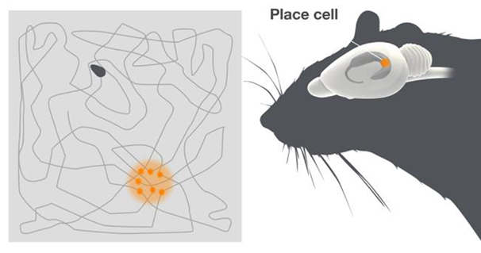
O’Keefe 1976

Slide 5
Steps of the Analysis Pipeline

Slide 6
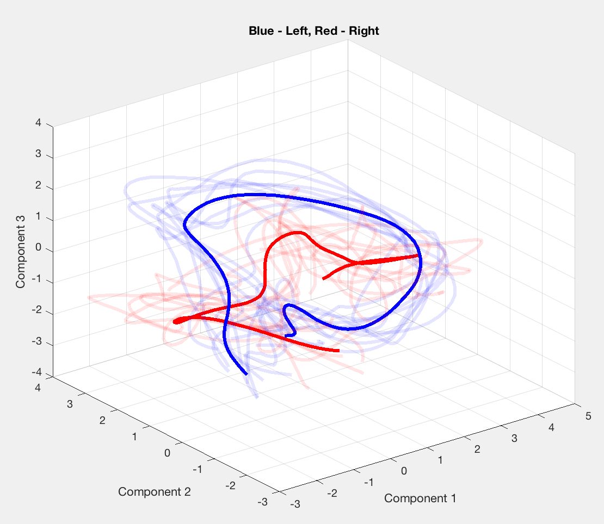
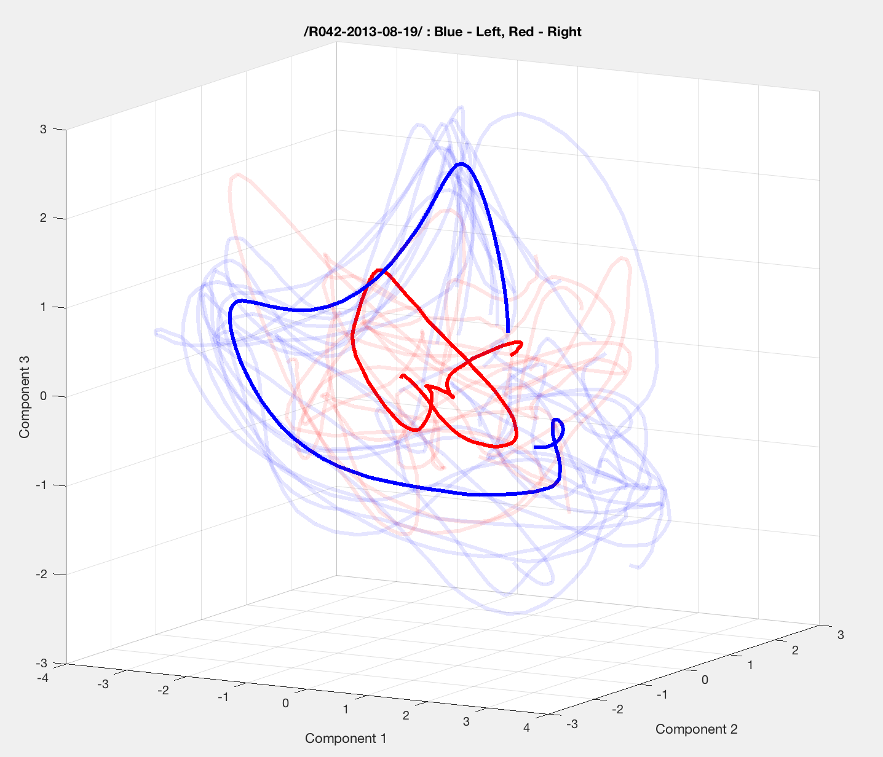
Animal R042 – Day 1
Animal R042 – Day 2
Blue – Left
Red – Right

Slide 7

Trajectories Through PC Space
Notes:
Right

Slide 8
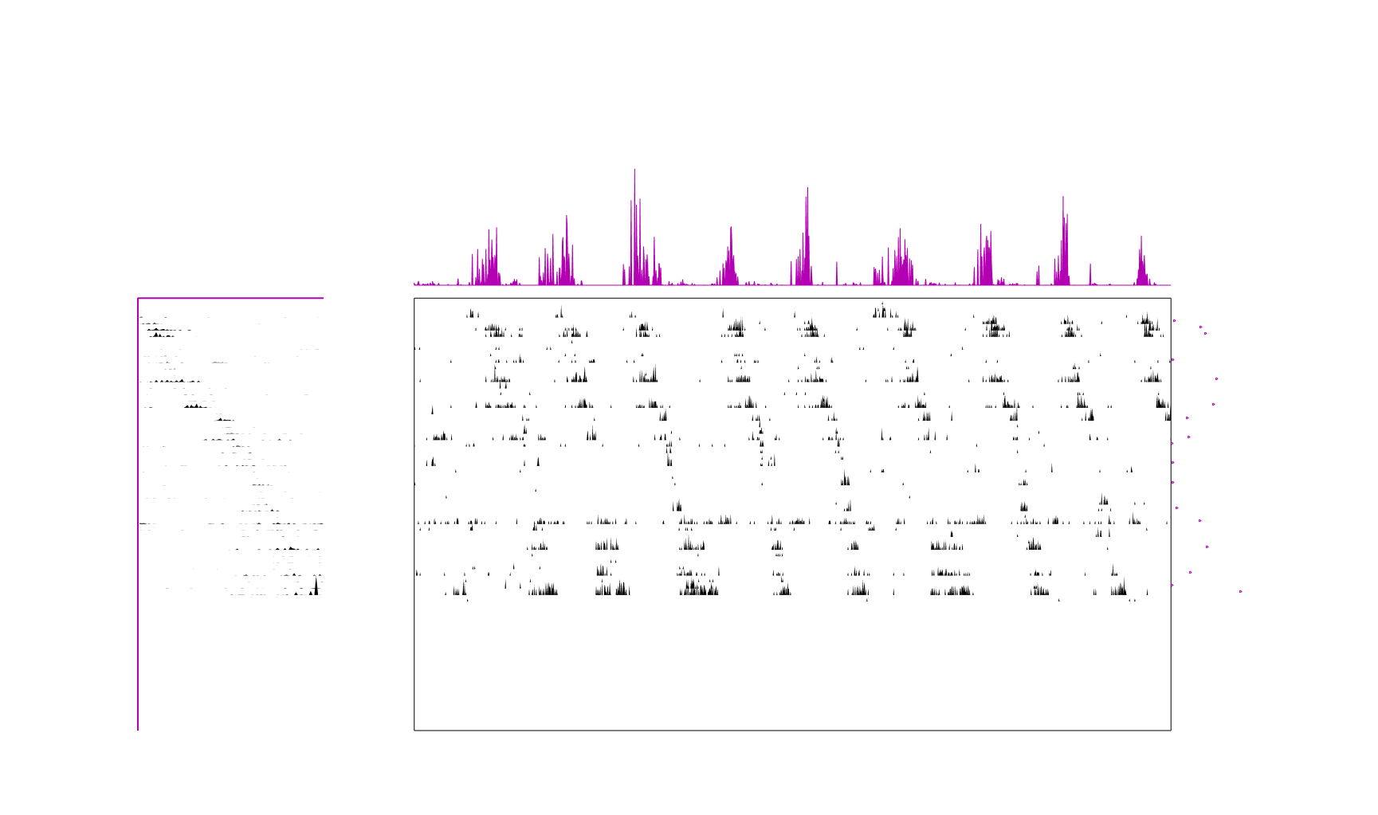
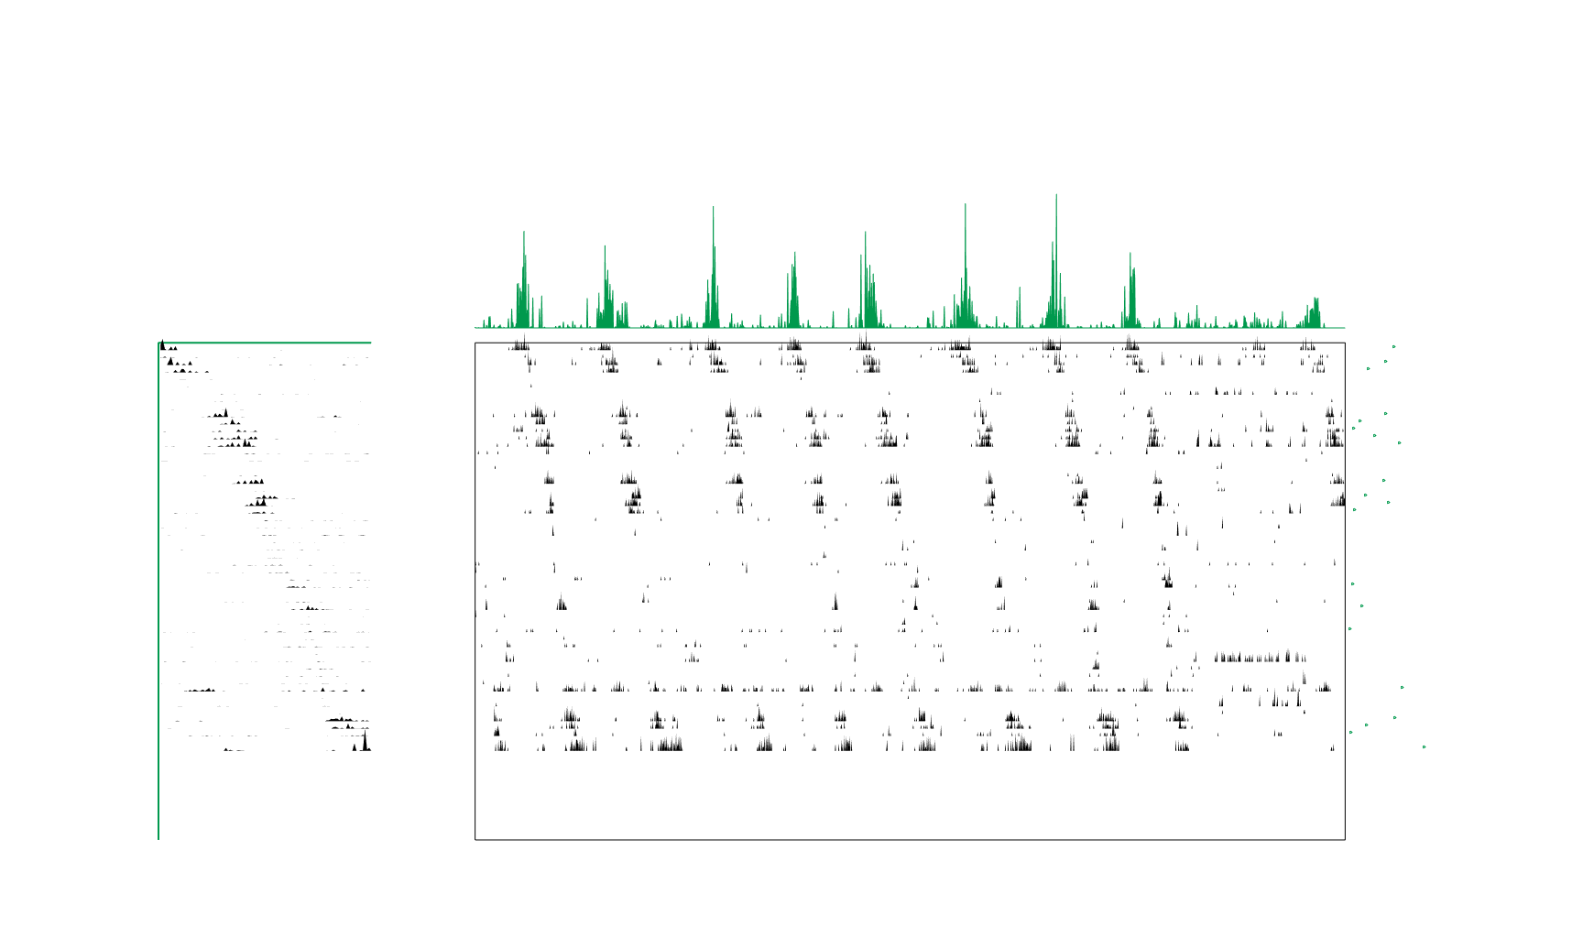
Sequence Detection with seqNFM
Left trajectory
Right trajectory

